Slide 1
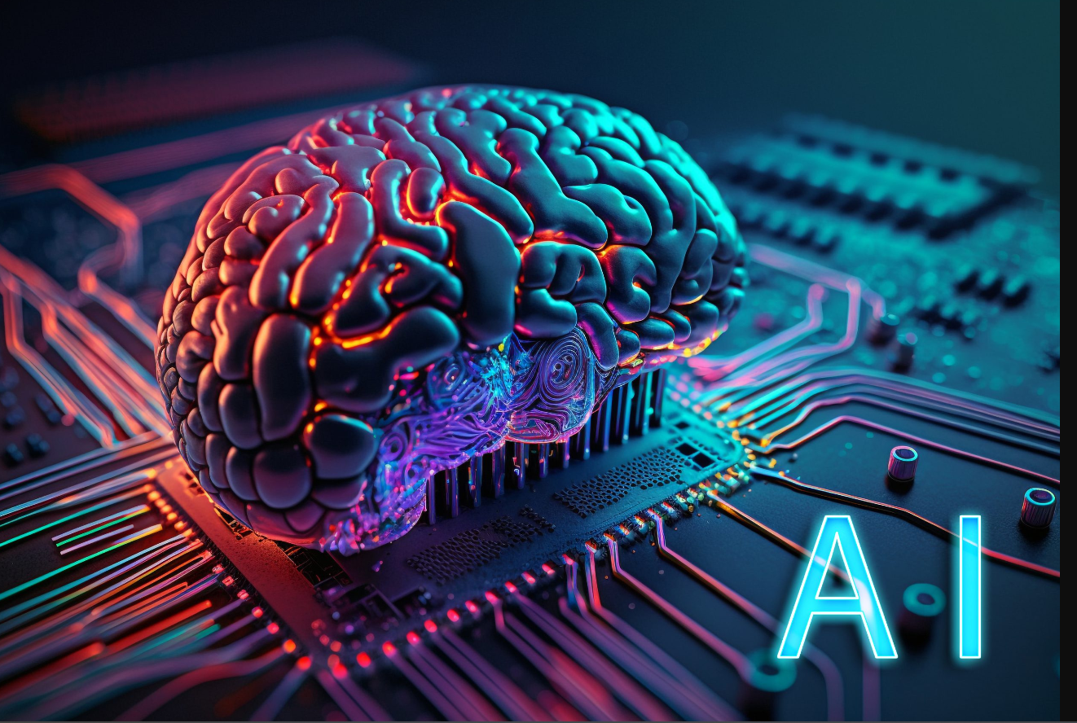
How AI is Helpful to Tourism
By: Navya,Azmah and Presha
Date: 27/07/’23

Slide 2
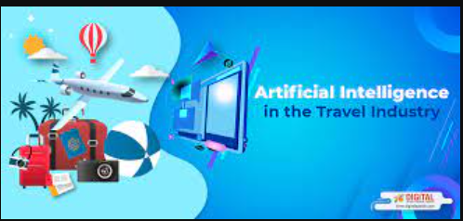
How AI changing the Travel Agency
Currently, AI has been incorporated into many areas of the travel and tourism industry, making lives easier for travelers around the globe. For instance, there are some widely used forms of AI in airports these days, such as facial recognition systems and airport security scanning devices.

Slide 3
Real Life Examples
AI assistant for Travel Booking
Robots for Face-to-Face Customer Service
AI driven applications for Flight Forecasting
Data Analytics To Identify Valuable Insights
Sentiment Analysis Through Social Media
Smart Baggage Handling

Slide 4
Advantages and Disadvantages
Advantages
Customized Travel Planning
Online Customer Service with Chatbots
Data Analysis and Processing
Intelligent Baggage Handling
Facial Recognition
Dynamic Pricing
Disadvantages
Cost and ROI
Integration with existing systems
Ethics and privacy
Adoption and resistance
Maintaining and upgrading systems

Slide 5
Conclusion
In Conclusion, the travel and tourism industry has seen a surge of AI applications on every spectrum. In this article, we have discussed some popular applications of AI and how they operate. As discussed, be it by air or sea, there are potential ways passengers and travel companies can utilize AI to make the journey an efficient and smooth one while maintaining customer satisfaction at a higher level.

Slide 6
Thank You

